Slide 1
Mini Project
Perfect Holiday - A travel website
~ Archana Bathula

Slide 2
Navigation
Home
About us
Destination
Backpacking
SignUp

Slide 3
Home page
Home page consists a background image with two buttons
1. Discover Places
2. Book now
Discover places button routes to destination page where user can see trending places.
Book now button routes to Book now page where user can login.

Slide 4
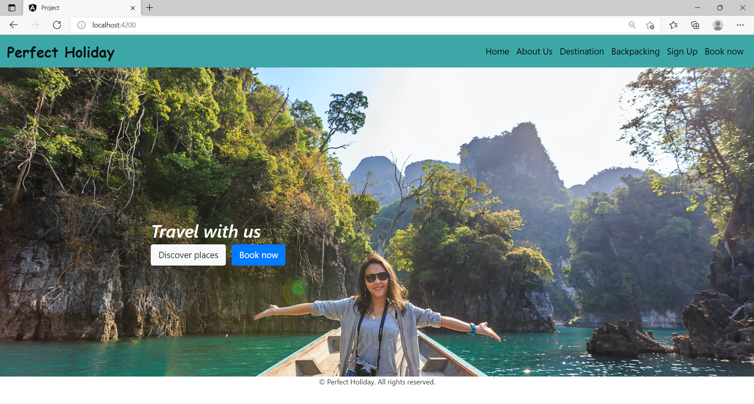
Home Page

Slide 5
About Us page
About us page consists of description about our website.
Explaining what we serve and offering users.
Follow us links are mentioned where in user can follow our page in different social media platforms.

Slide 6
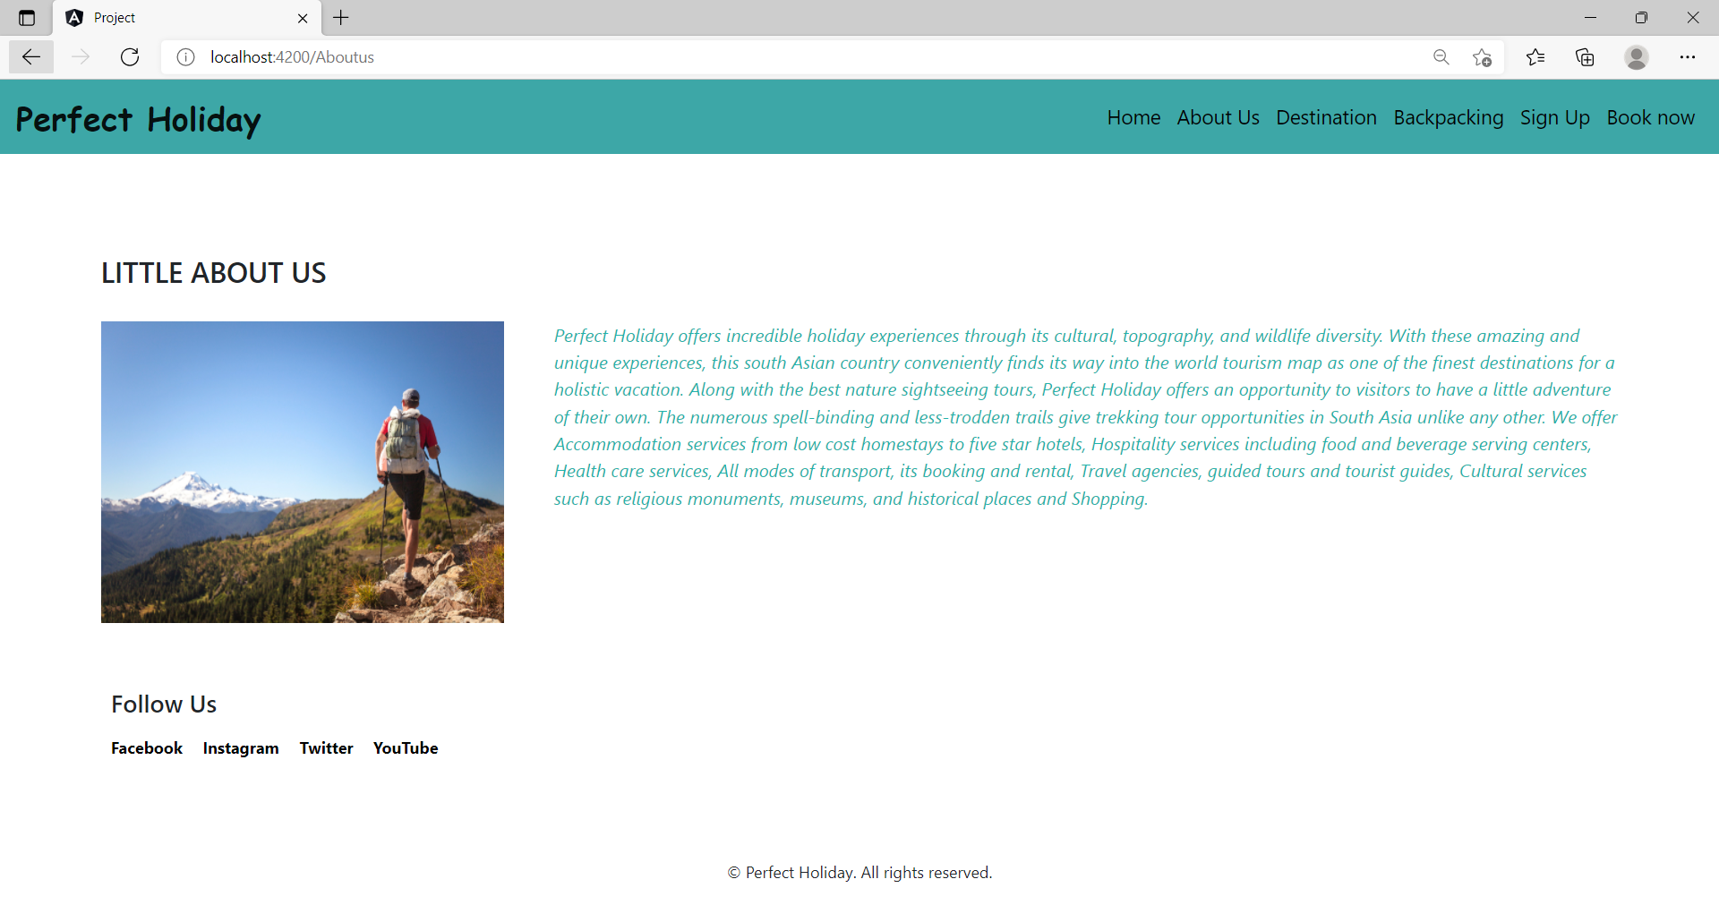
About Us

Slide 7
Destination Page
Destination page consists of top trending holiday destinations as cards.
Places with little description and book now button.
Book now button on clicking routes to login page.

Slide 8
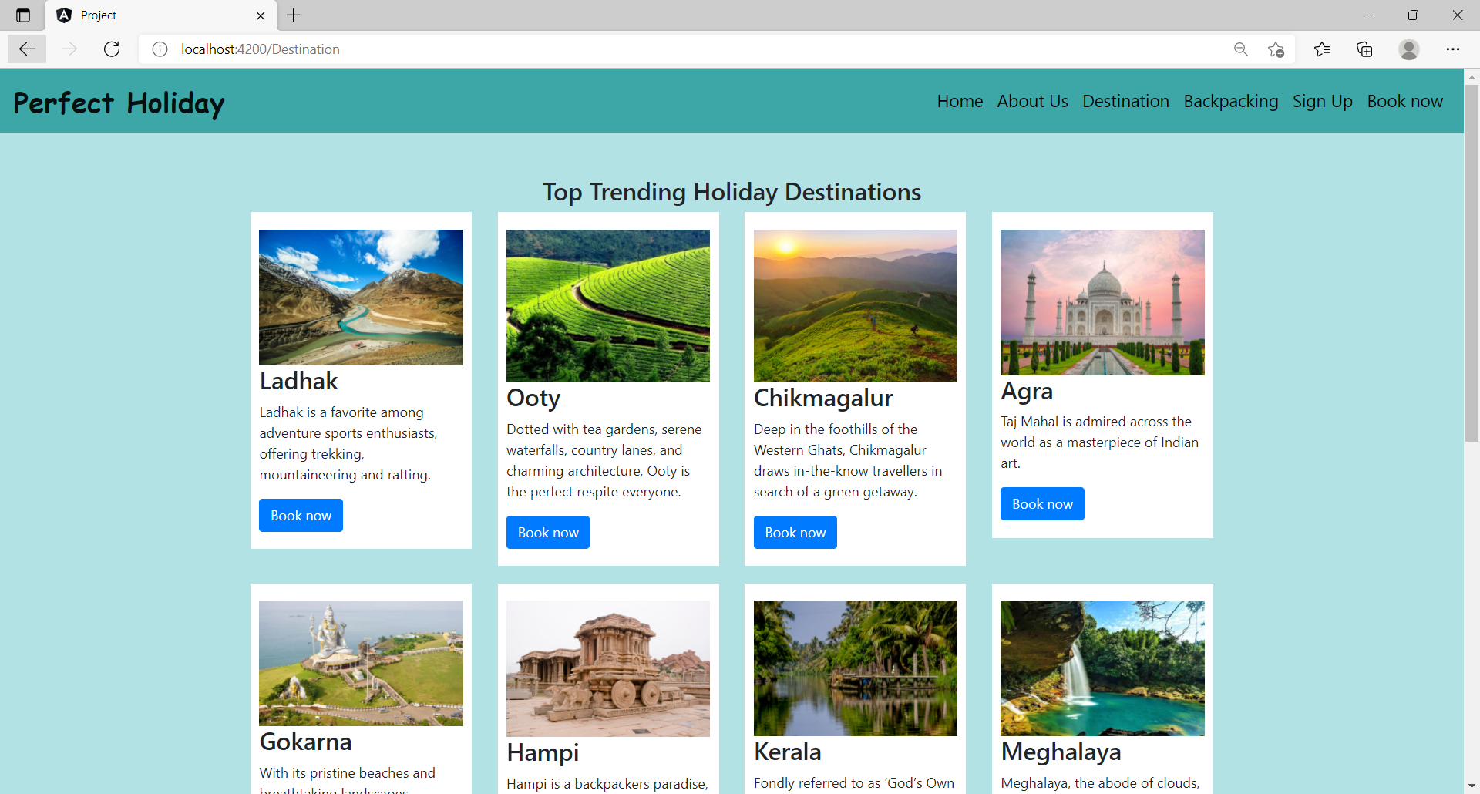
Destination

Slide 9
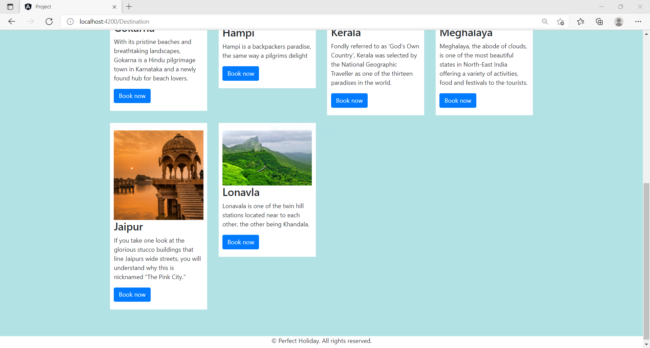
Destination

Slide 10
BackPacking Page
Backpacking page consists of Trending packages in India.
Places with details of trip including price and book now button.
Book now button on clicking routes to login page.

Slide 11
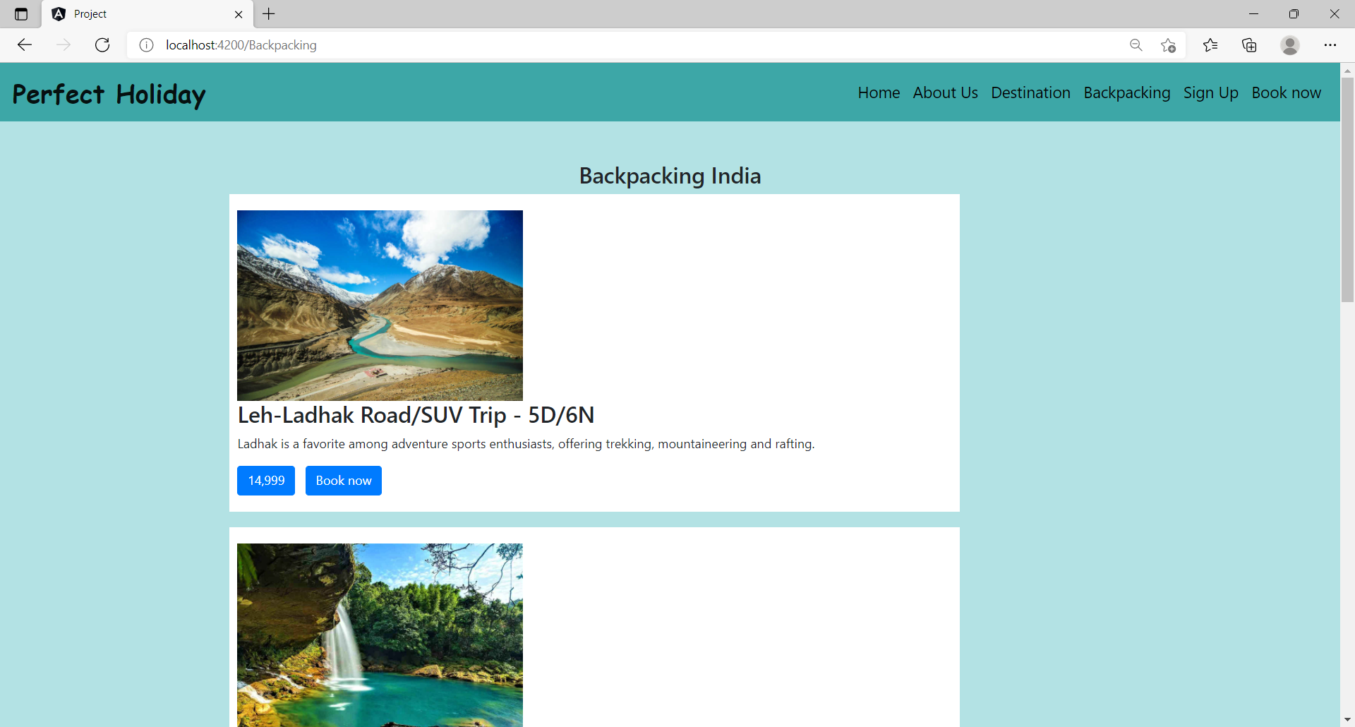
BackPacking

Slide 12
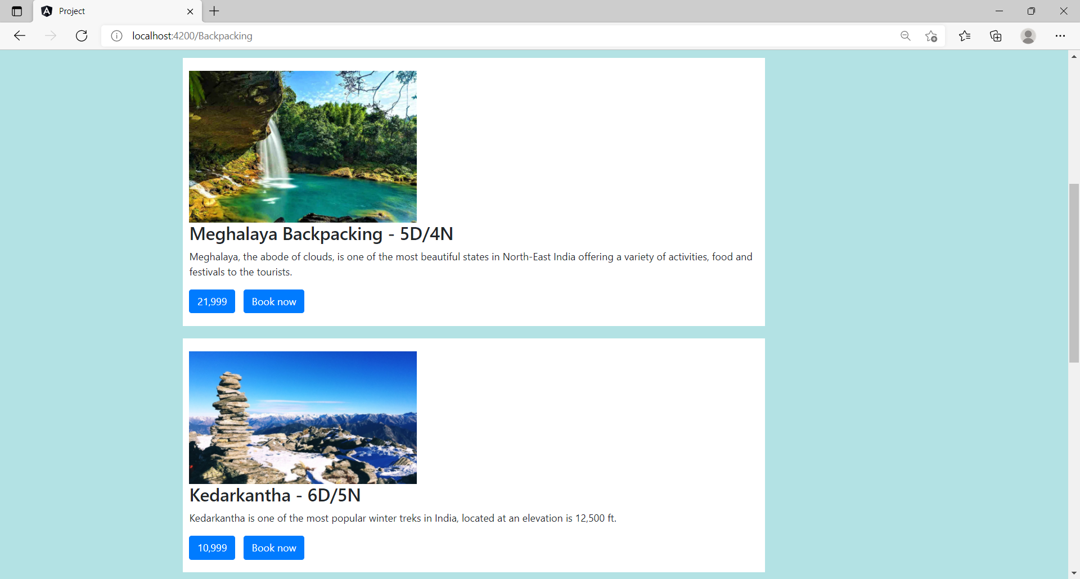
BackPacking

Slide 13
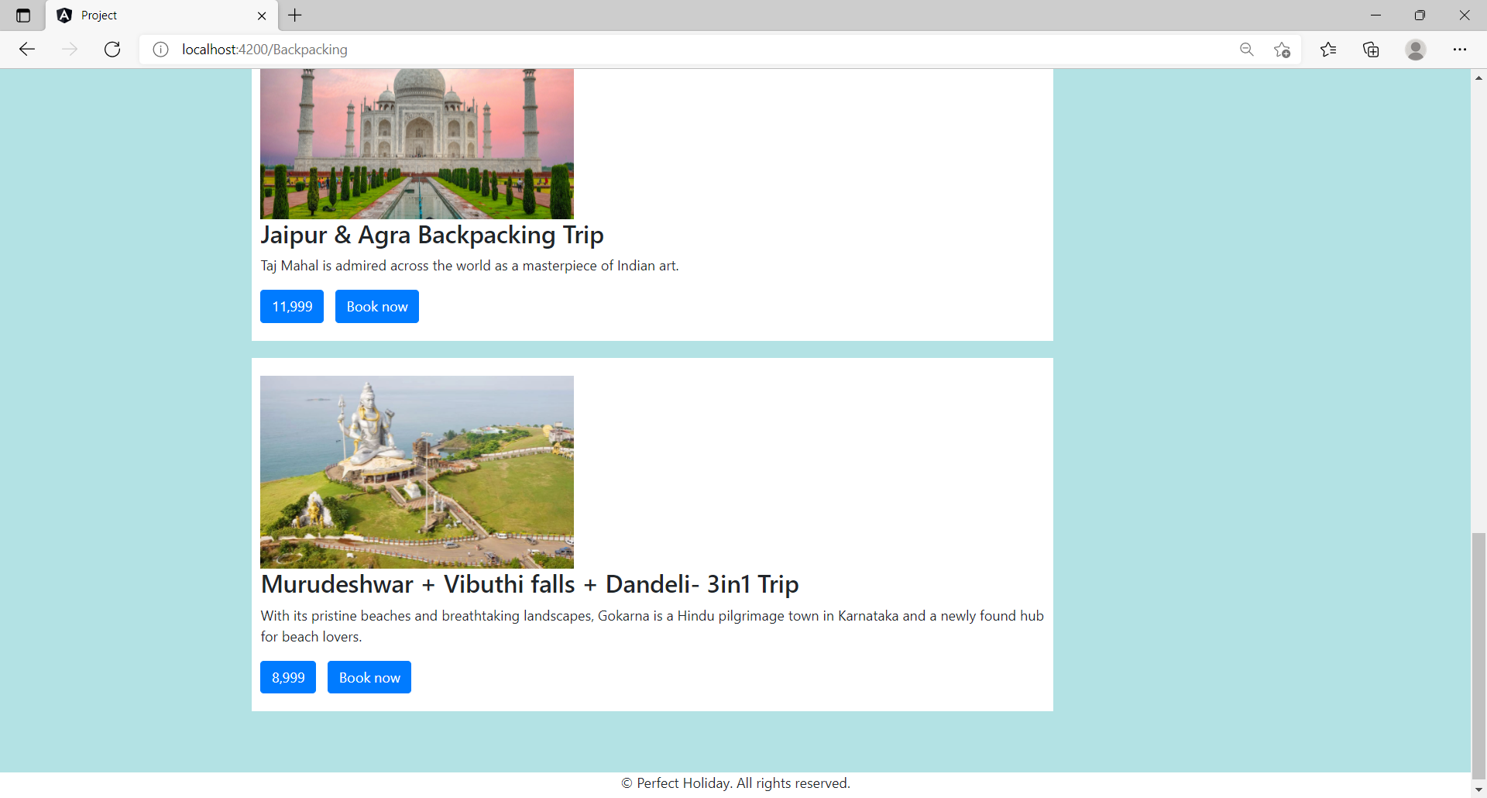
BackPacking

Slide 14
Sign Up Page
Sign up page consists of Registration form with validations.
1. User Name - Only characters allowed.
2. Mobile Number - Only numbers allowed and maximum length is 10.
3. Email Address - Alphanumeric with ‘@’ and ‘.’ (valid email)
4. Password - Password Must Contain(4-15)length, 1-char, 1-number
5. Sign up button - button on click routes to desination page.

Slide 15
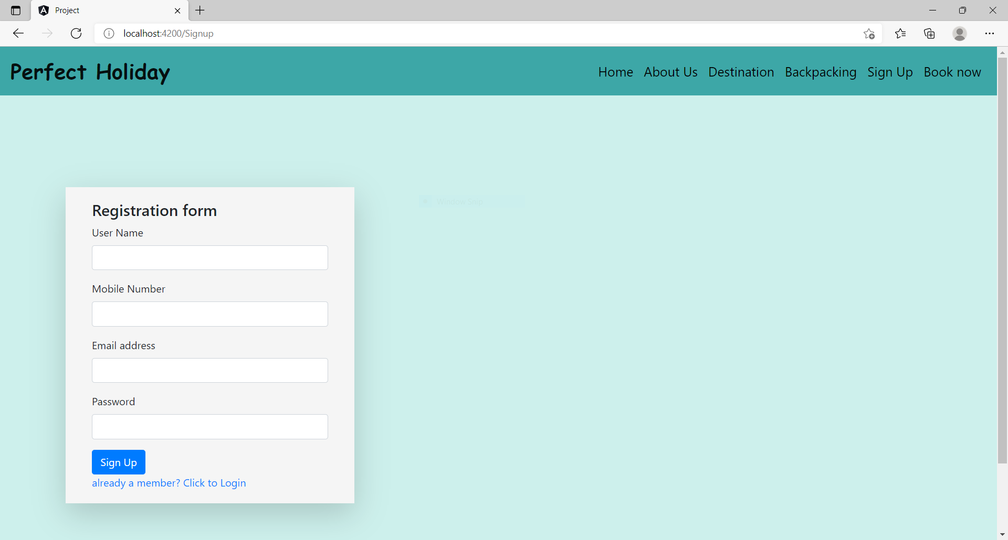
Sign Up

Slide 16
Book Now Page
Book now page consists of Login form with validations.
1. Email Address - Alphanumeric with ‘@’ and ‘.’ (valid email)
2. Password - Password Must Contain(4-15)length, 1-char, 1-number
3. Login button - button on click routes to desination page.

Slide 17
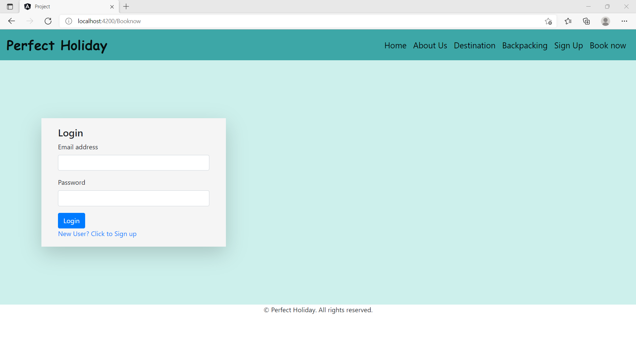
Book Now

Slide 18
Thank you

